Slide 1

Introduction to VueJS
JavaScript Frameworks 1/3
Andrew Fletcher
4th September 2019
Notes:
Welcome everyone.
First in a series of talks over the next few weeks

Slide 2
Agenda
Looking Back
What is Vue?
Core Concepts
Why use it?
Notes:
Have a look back at a traditional method and the problems faced.
A look at what Vue is and where it helps.
Some of the core concepts.
Some reasons to use it.

Slide 3
Back in the day
Structured backend
Messy frontend
Notes:
Traditionally, we had a very structured backend. We used patterns like MVC, MVVM, SOLID Principals, REST etc etc. Put a lot of thought into creating a good, well thought out backend that we could test well.
Unfortunately, things weren’t as good on the frontend. We used the likes of jQuery
We manually fetched data, manually updated the DOM, manually handled events, decorated elements with IDs, classes and attributes, scattered over multiple files.
All very manual and very error prone. We can do slightly better!

Slide 4
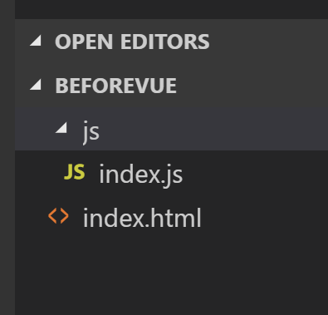
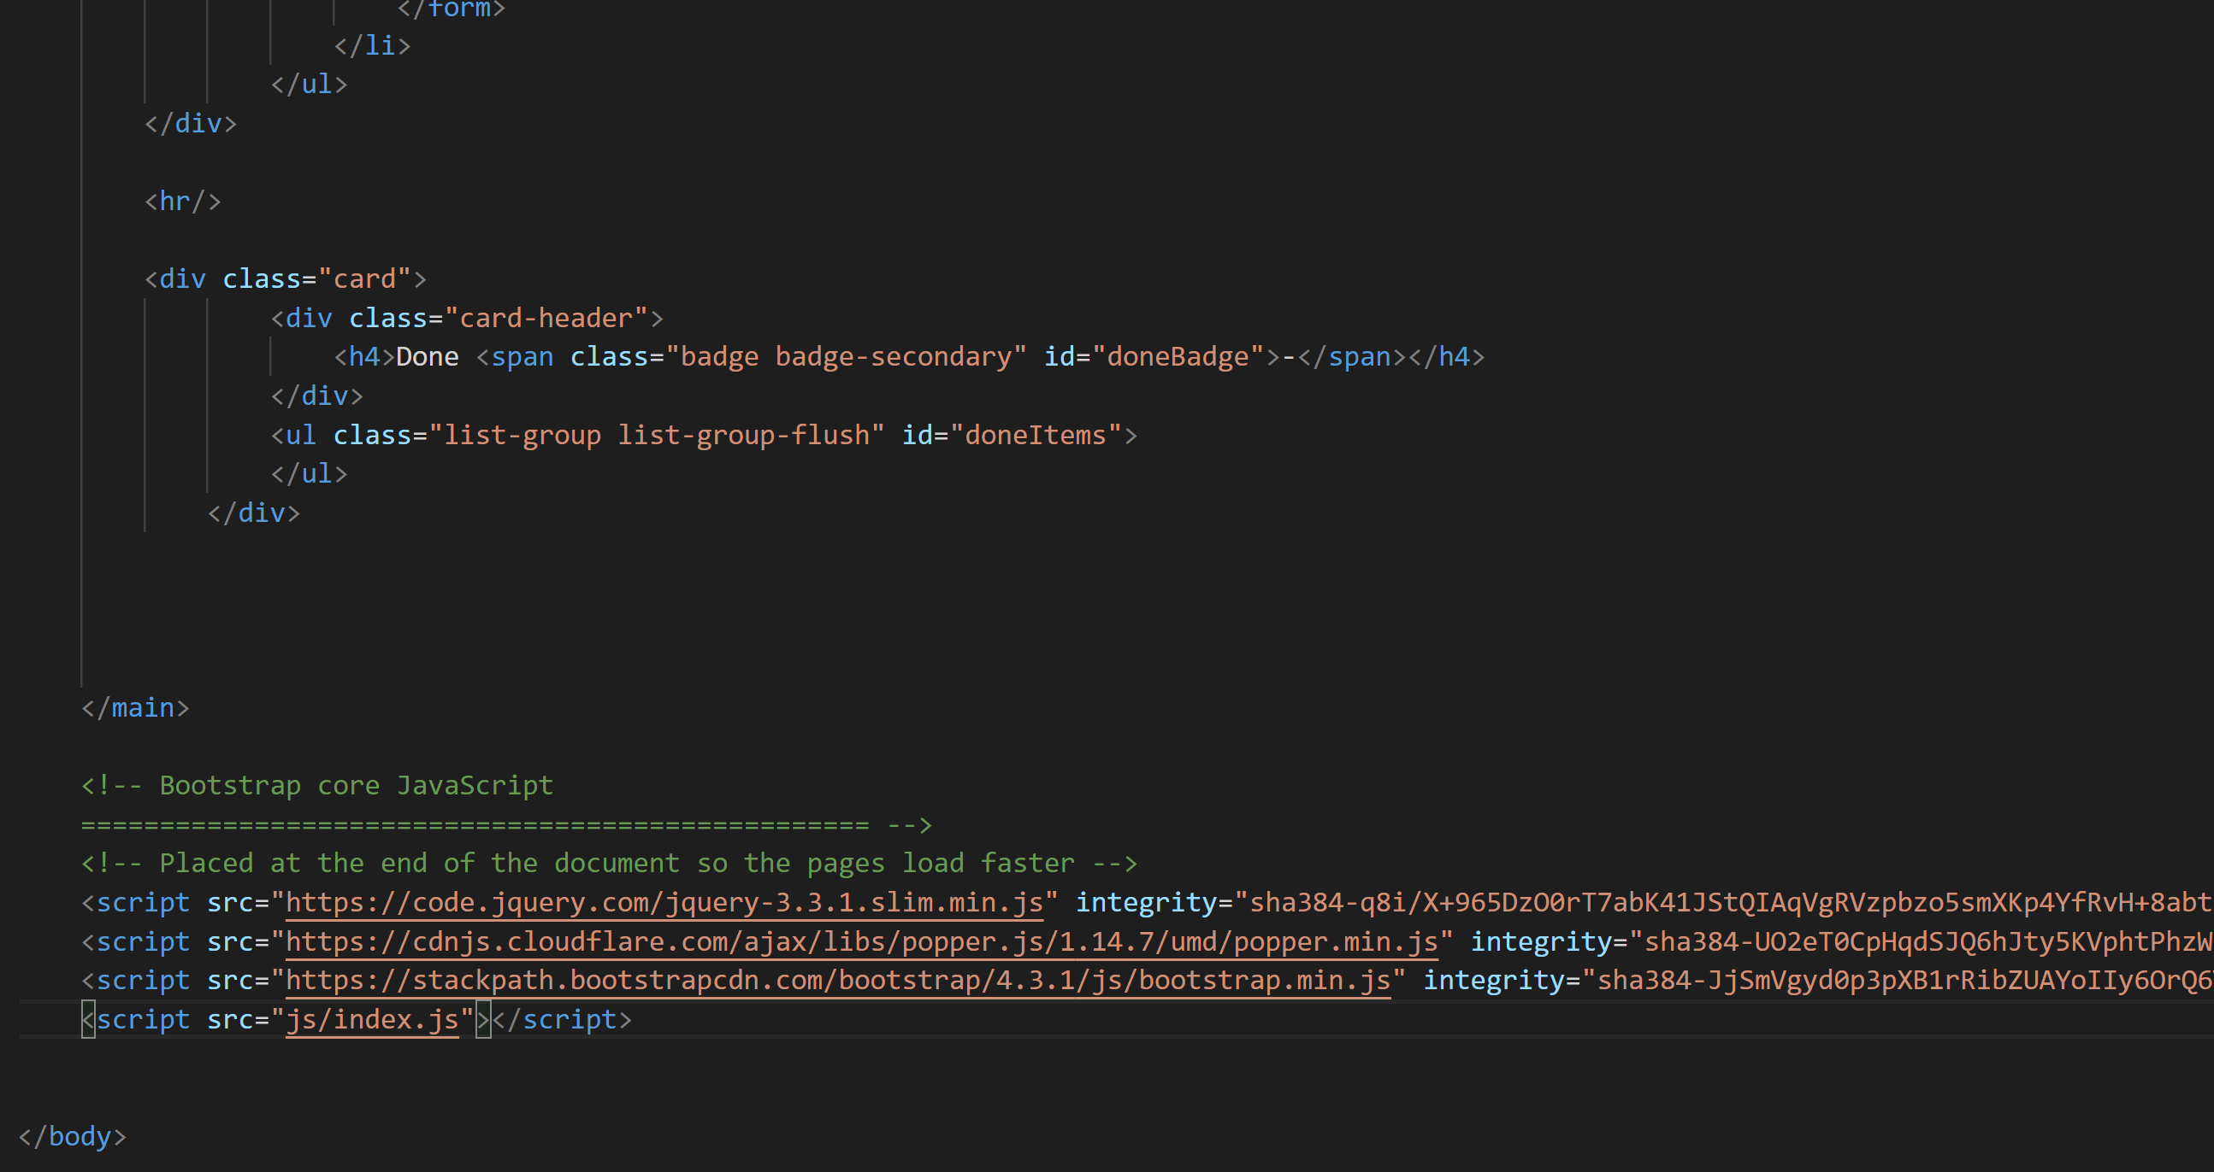
Notes:
Example of a typical project. Hand-crafted HTML and JS files, all spread out. Disjointed and error prone. Show demo project

Slide 5
What is Vue?
A library for building interactive web interfaces.
MVVM for the Web
Not a full framework
Notes:
Lets us build web UI in a structured way.
Provides an implementation of the MVVM pattern, however, doesn’t push a full framework on us. Vue lets us work in our way with whatever tools we like.
Based on some of the common patters seen in Angular and React.

Slide 6
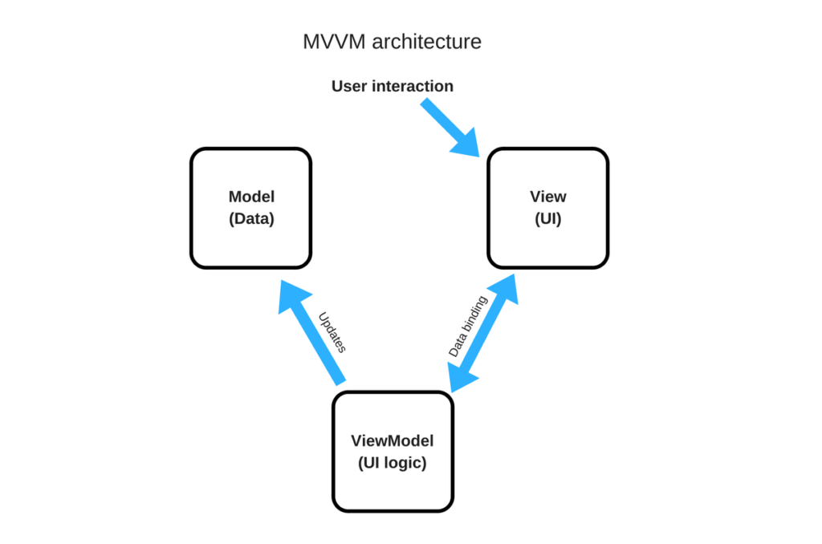
MVVM
Notes:
What is MVVM?
Model View View Model.
We fetch a model from our backend.
Our view is 2-way-bound to an intermediate representation called the View Model that contains all of our view logic.
The view is displayed from data in our view model and dispatches user actions to our view model.
We don’t modify the view directly. We update the data and the view automatically updates to match.

Slide 7
Concepts
Components
Declarative Rendering
Directives
Handling User Input

Slide 8
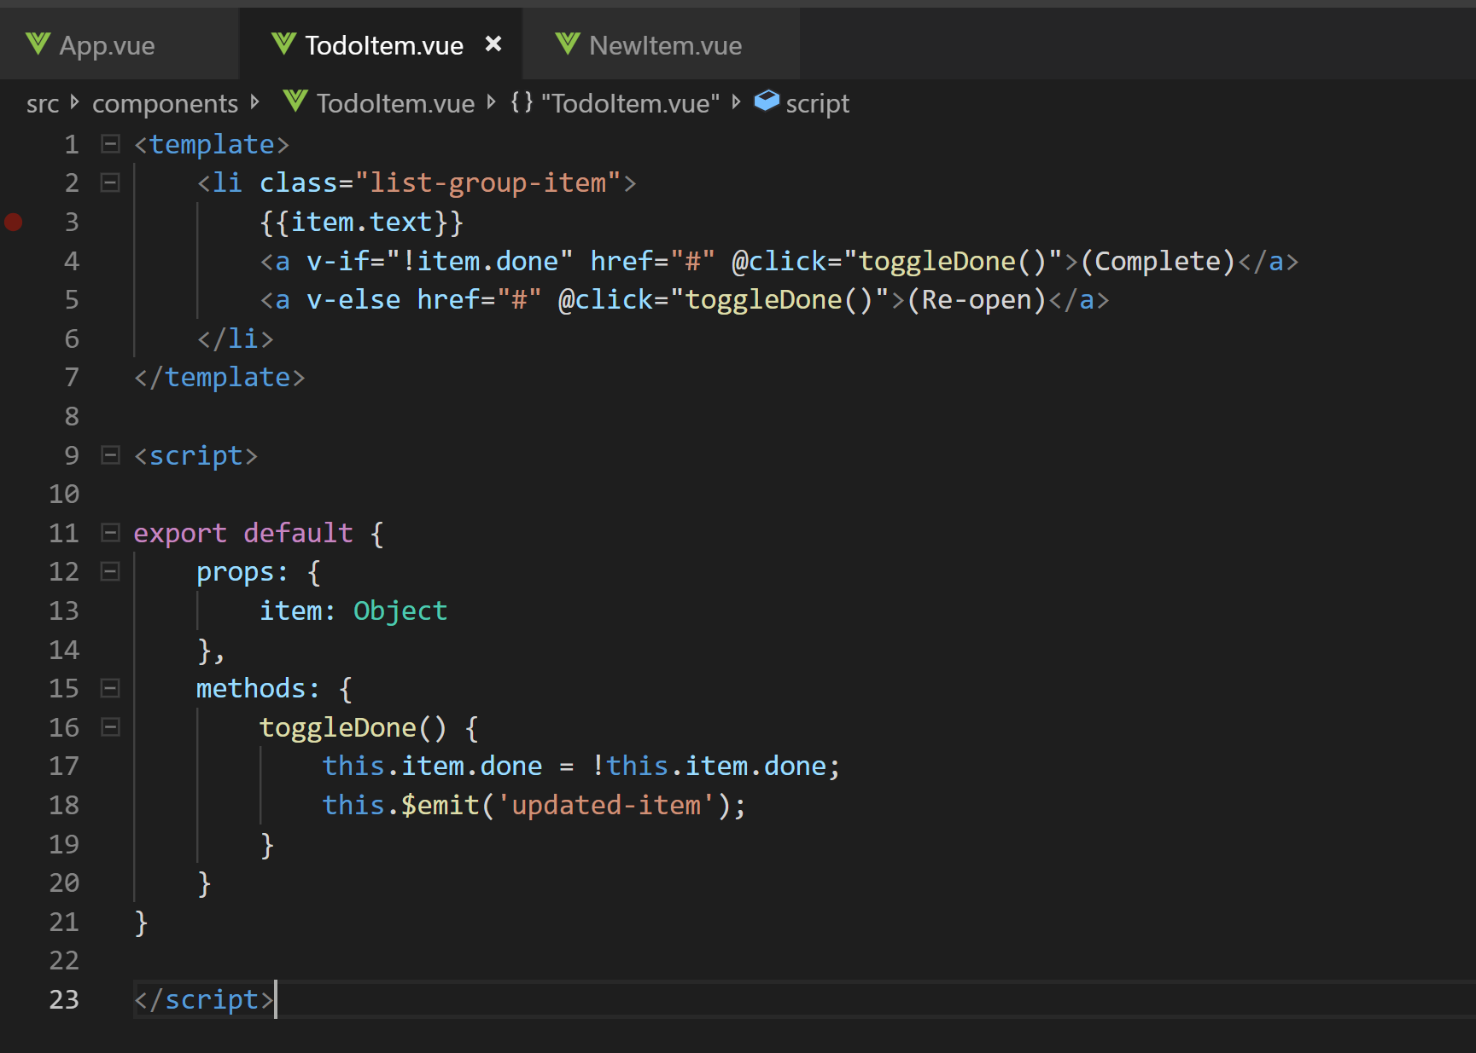
Components
Notes:
One of the issues in the traditional method is that everything is scattered. View and logic are mixed and we have to jump between HTML and JS.
Vue proposes an approach called a Single File Component. All the HTML, JS and CSS for a discrete area are in one place.
Gives a way to properly split our concerns (data vs view), whilst keeping our logic in one file.
Components have data and properties that are rendered based on a template.
Components contain logic to handle user actions.
Components can be passed parameters and can raise events.

Slide 9
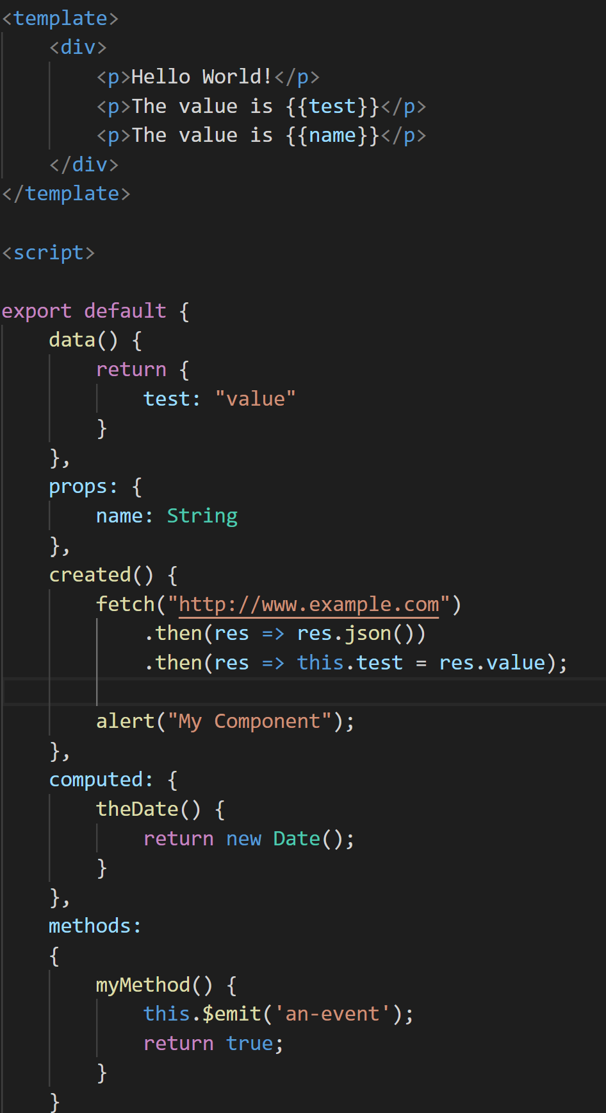
Notes:
A look at a fully fleshed out Hello World component.

Slide 10
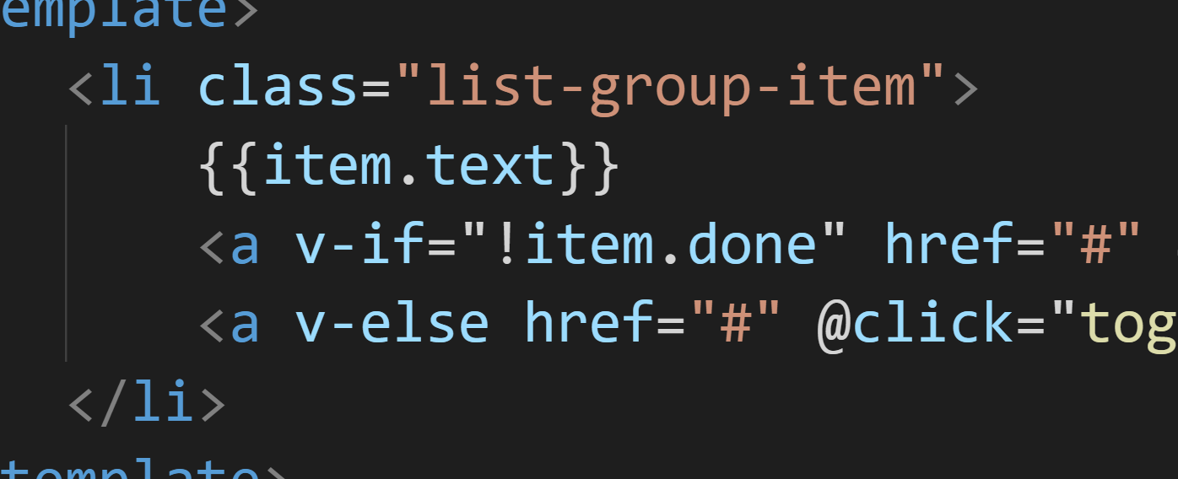
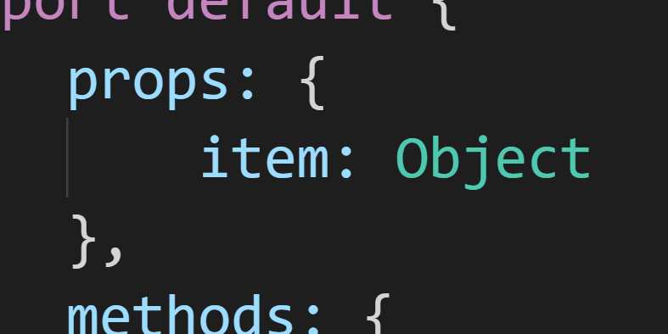
Declarative Rendering
Notes:
At the core of Vue is a 2 way binding framework that allows us to render data to the DOM using templates.
Vue is reactive – we define a template and we give it data. As we change the data, the view is automatically updated.

Slide 11
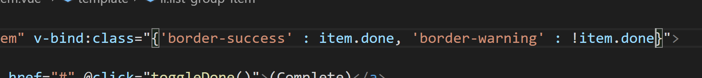
Directives
Notes:
Vue provides a number of special attributes that allow us to apply this reactive behaviour to the DOM in different ways. These are called Directives. They’re normally prefixed with v- to indicate that they are provided by Vue.
We can bind attributes, in this case, a class is set based on a data property.
As we saw before, we can bind for display using the {{ }} syntax.

Slide 12
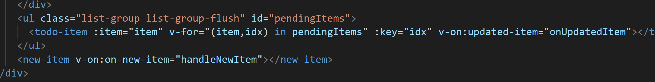
Directives
Notes:
Interestingly, we can make not only text and attributes reactive, but, the DOM structure as well. Entire nodes of the DOM can be looped based on our data with v-for

Slide 13
Directives
Notes:
Another is v-if and v-else. All of these respond automatically to changes in the data. We never need to modify the DOM directly.

Slide 14
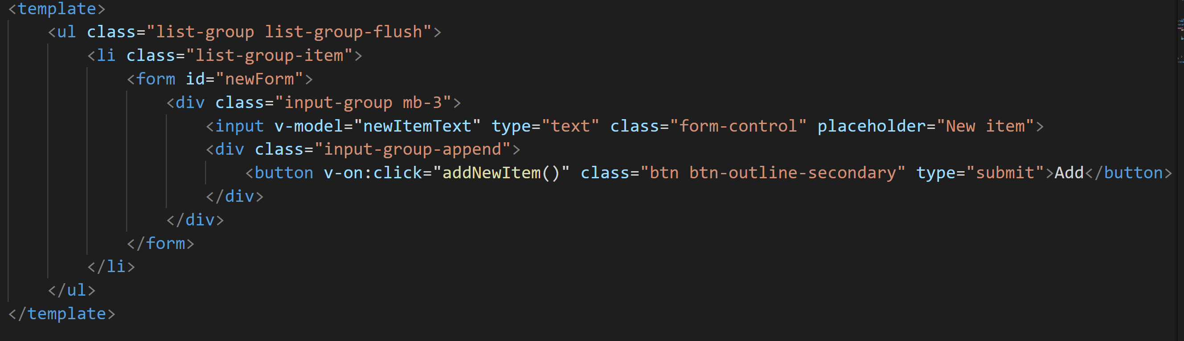
Handling User Input
Notes:
This reactivity is not just one way – input fields are 2 way bound such that the field displays the initial data and the data is updated based on the value of the field. Events such as clicks can also be easily bound to logic on our component. No more having to separately wire up event handlers using jQuery .on

Slide 15
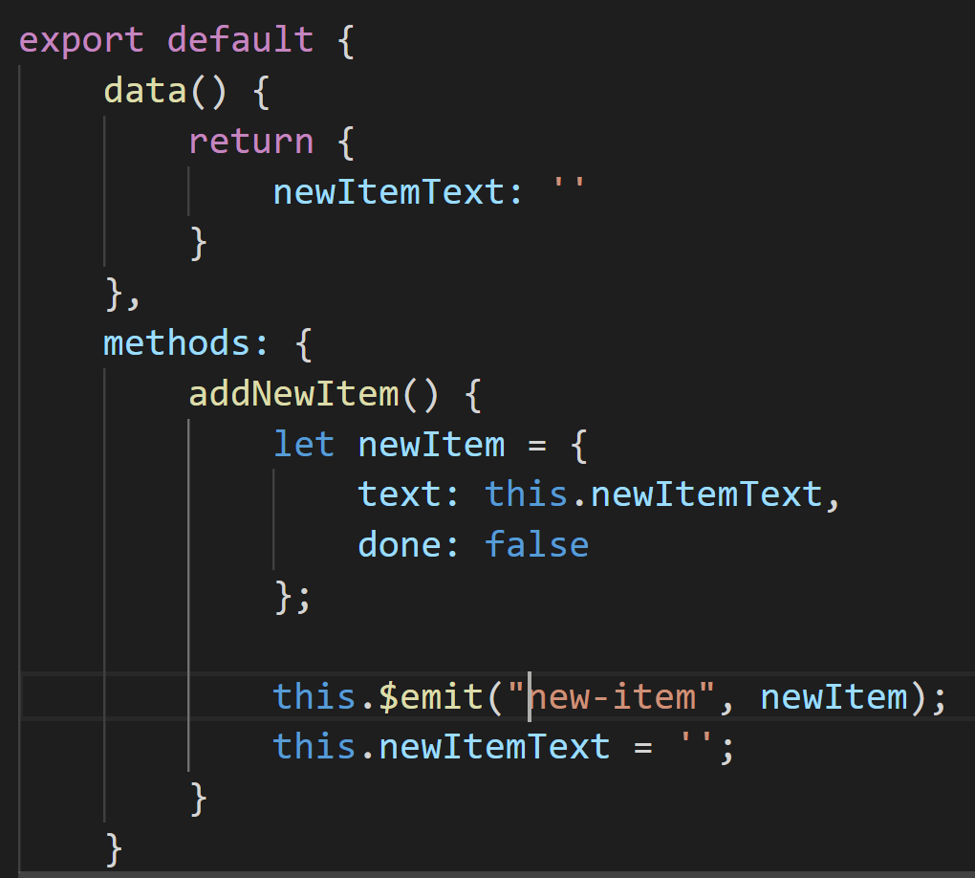
Handling User Input
Notes:
In our event handlers, again, we update the data and the UI aligns automatically. No having to touch the DOM.

Slide 16
A basic project
Notes:
Lets have a look at a basic project built in VueJS

Slide 17
Why use it?
Excellent Documentation
Vibrant Ecosystem
Design Freedom

Slide 18
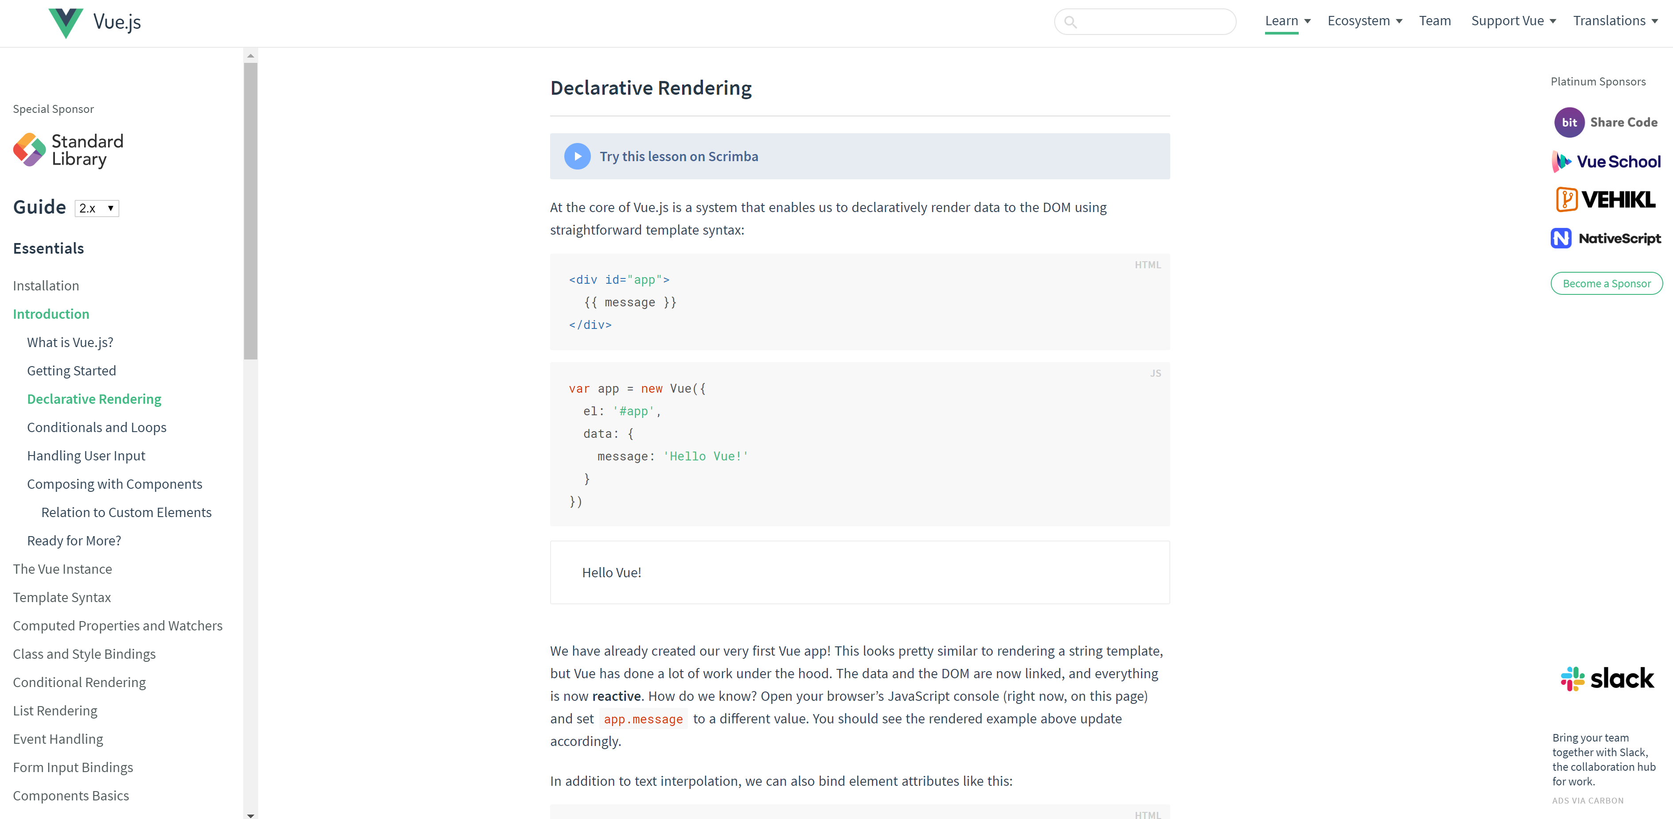
Excellent Documentation
Notes:
Docs are really in-depth. Filled with examples covering all the various ins and outs of using VueJS

Slide 19
Vibrant Ecosystem
Vue CLI
Vue Router
Vuex
Vue Server Renderer
>26k more on NPM
Notes:
Really vibrant ecosystem. Vue is a batteries included library, but, it does not force you to use these.
Vue CLI – a command line interface for generating and working with projects. Generates the project, builds and locally serves the project.
Vue Router – allows you to easily build SPAs. Manages transitions between pages, URL parameters etc.
VueX. A state manager. Allows state to be centrally stored. An implementation of the Flux pattern made popular by Redux.
Vue Server Renderer – allows a vue app to be pre-rendered on the server before it is shipped to the client.
NPM – covering various UI frameworks, various kinds of controls, payment components, you name it!

Slide 20
Design Freedom
Single Page Applications
Server Side Rendered sites
Individual Components
Notes:
Really flexible as to what you use it for. Doesn’t push a particular paradigm.

Slide 21
Thanks for listening!
Any questions?
https://github.com/andrew51017/IntroVueJS

